Slide 1
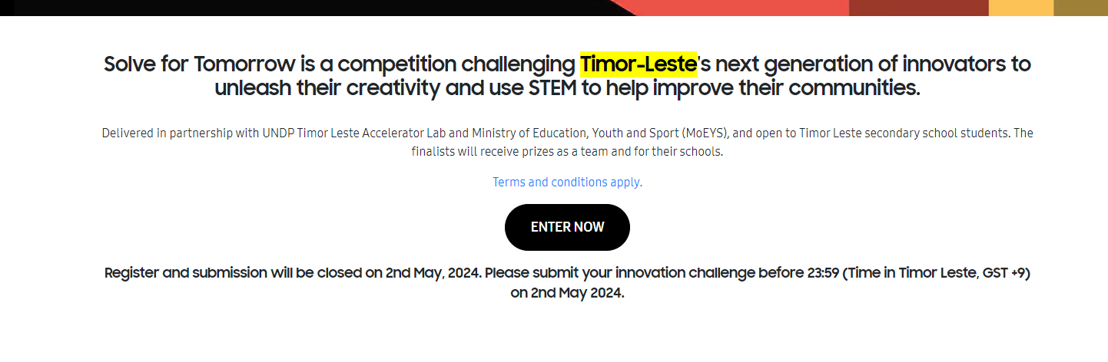
❶
❷
❸
❹
Timor-Leste to Tuvalu
UNDP Timor Leste Accelerator Lab to The University of The South Pacific Tuvalu Campus
Timor Leste secondary school students to Tuvalu secondary school students
Register and submission will open on 13th September 2024. (Remove Enter Now CTA for now, but let’s prepare a Entry form in backend.

Slide 2

2023-2024

Slide 3
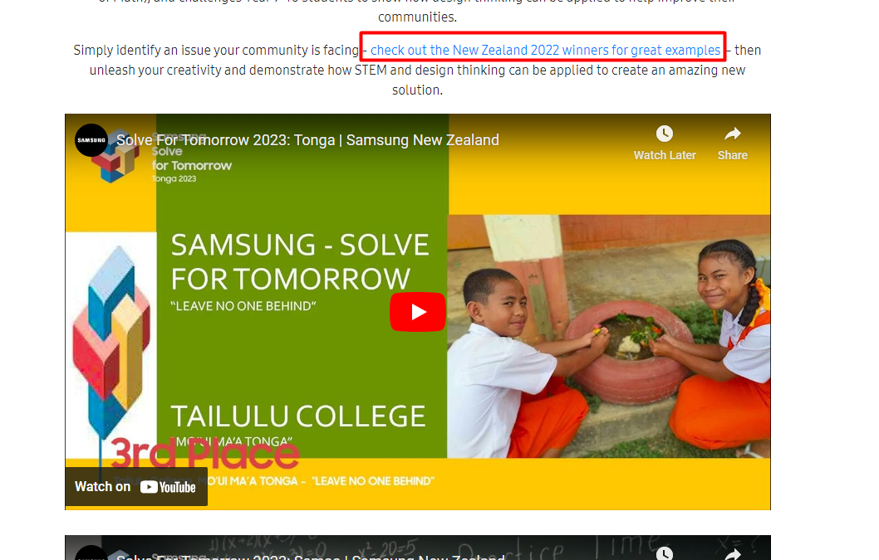
Change the wording to → check out the New Zealand 2023 winners and the Pacific winners for great examples
(the year updated, the link updated)

Slide 4
Prizes
1st Place: Cash Prize $2000 USD Voucher + Samsung tech devices for winners
2nd Place: Cash Prize $1200 USD Voucher + Samsung tech devices for winners
3rd Place: Cash Prize $500 USD Voucher + Samsung tech devices for winners

Slide 5
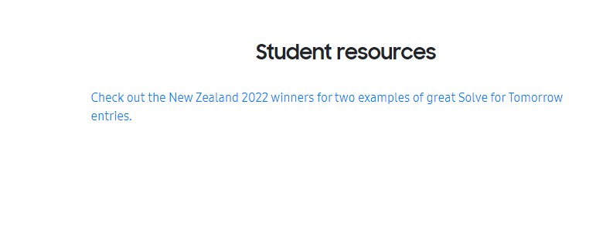
Update the year & Link
Check out the New Zealand 2023 winners for two examples of great Solve for Tomorrow entries.

Slide 6
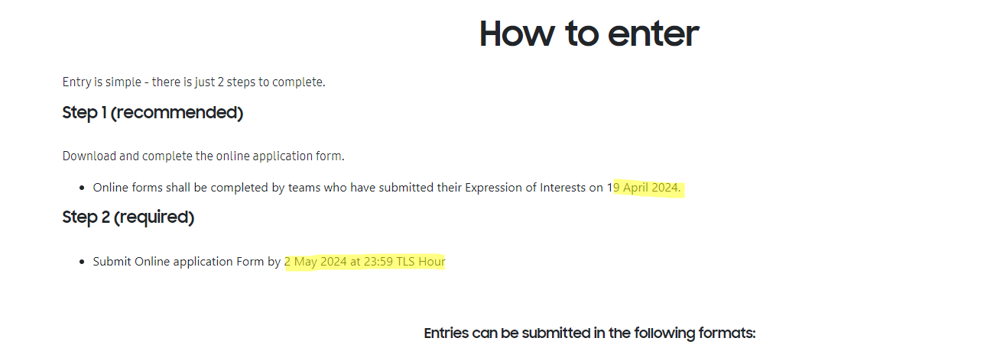
1) 20 September 2024
2) 4 October 2024 at 23:59 TVT Hour

Slide 7
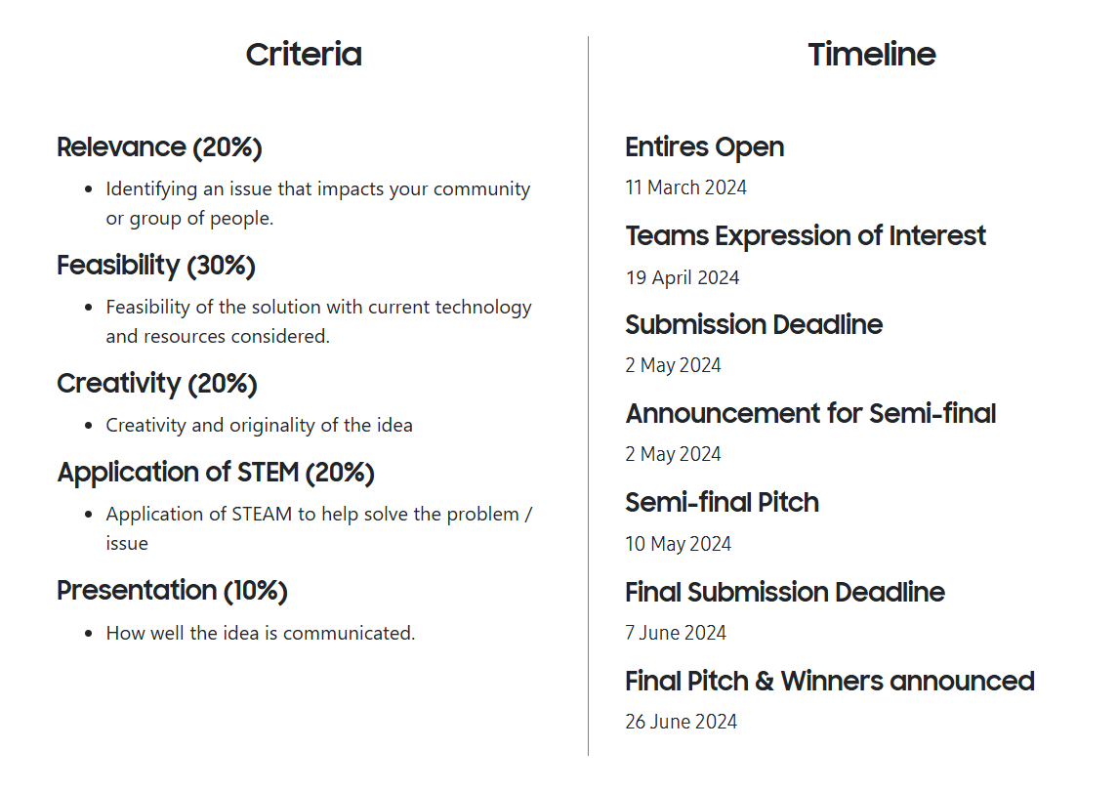
Typo → Entries
Timeline
Entries open : 13 September 2024
Team EOI : 20 September 2024
Submission Deadline : 4 October 2024
Announcement of Semi-Finalist: 7 October 2024
Final submission deadline : 4 November 2024
Final Pitch & Awards Ceremony: 15 November 2024 (TBC)

Slide 8
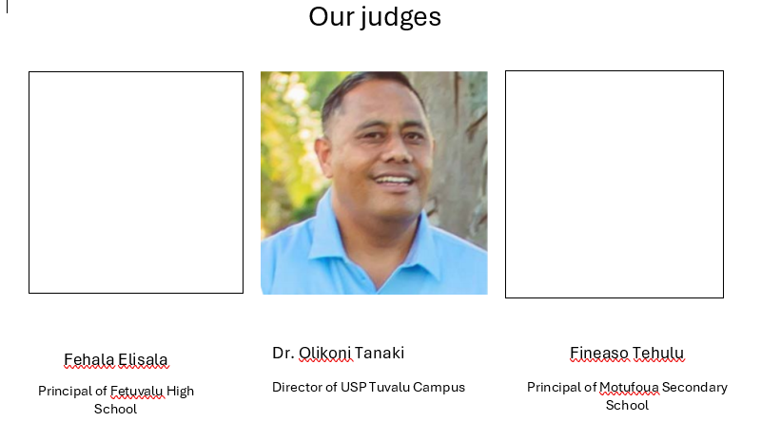
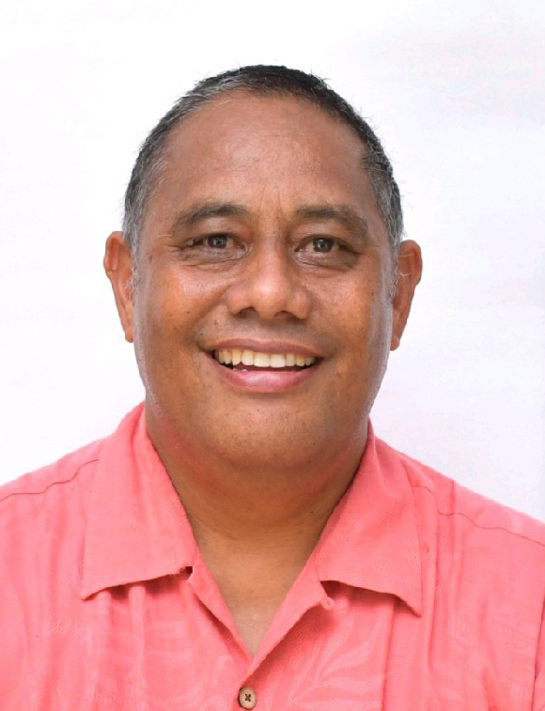

Slide 9
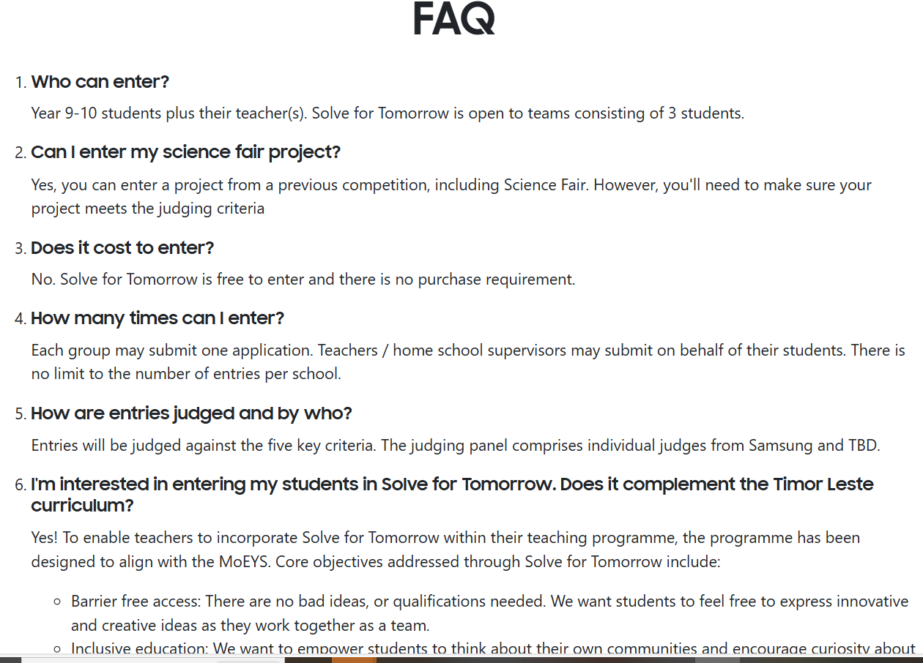
minimum 3 to max 5 students.
Tuvalu
Tuvalu Ministry of Education Youth and Sport

Slide 10

Can we add “Participating Schools” before “Partners” and add the below two logos?
Motufoua Secondary School & Fetuvalu secondary School
2) The partners logos will be updated with MoE Tuvalu & USP logo
Samsung Enabling People logo - MoE Tuvalu - USP logo
3) Email address to be support@solvefortomorrow.tv for Tuvalu programme.

